Slide 1
Qsymm
Find symmetry
Gen symmetry TB
Gen kp

Slide 2
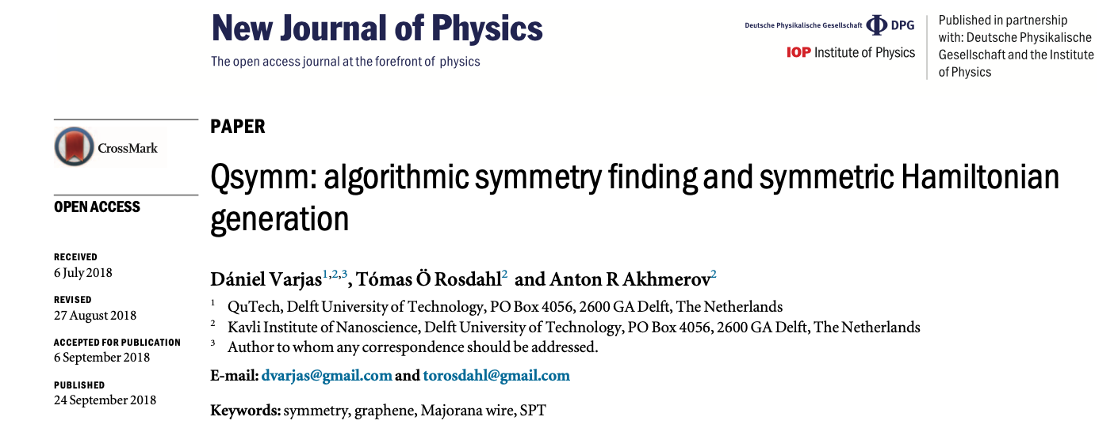
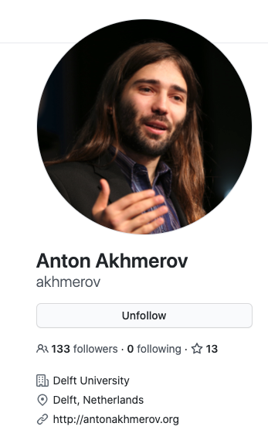
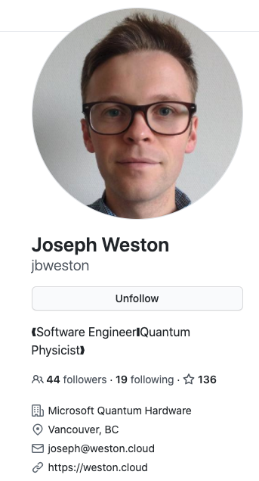


Qsymm · Introduction
https://github.com/quantum-tinkerer/qsymm
👍https://qsymm.readthedocs.io/en/latest/tutorial/tutorial.html
kwant
find all the symmetries of a given family of Hamiltonians
generate all possible single-body Hamiltonians compatible with a given symmetry group

Slide 3
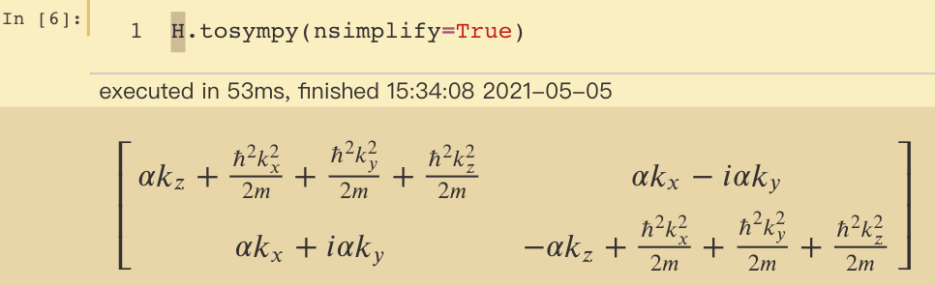
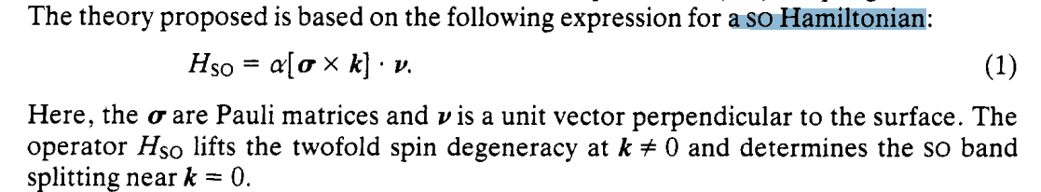
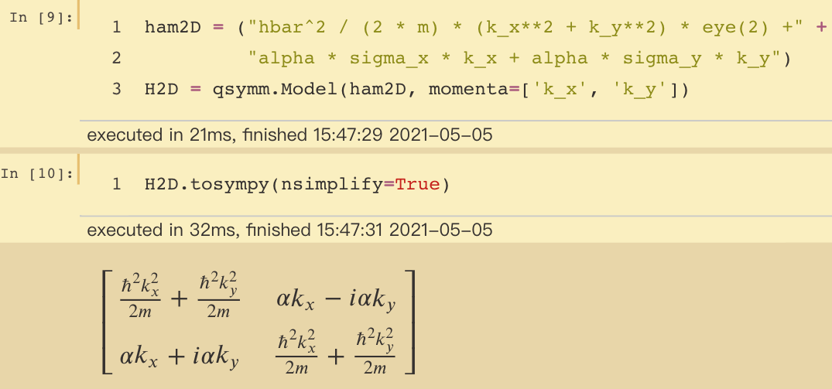
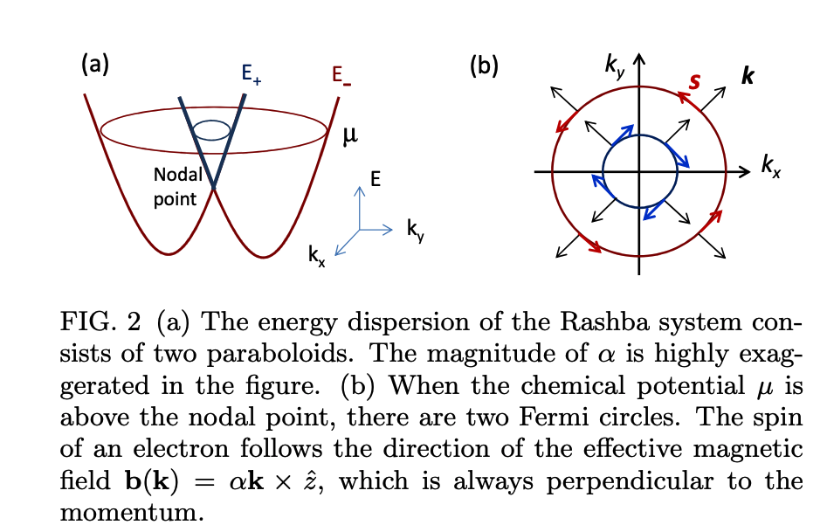
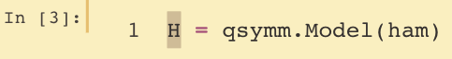
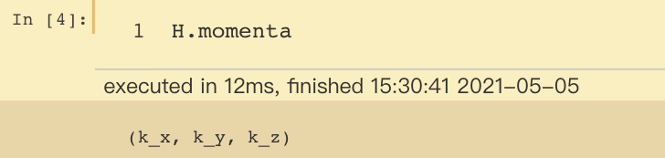
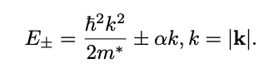
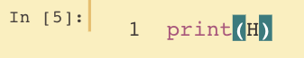
Define a model by a symbol like string
extract a more readable representation by using the tosympy method, which converts the Model to a sympy expression:
Yu A Bychkov and E I Rashba 1984 J. Phys. C: Solid State Phys. 17 6039
2DEG(electron gas)
E along z
^ -> **
sigma_x sigma_y sigma_z eye(2)
Note that Qsymm automatically interprets the symbols sigma_x, sigma_y and sigma_z as the Pauli matrices, and eye(2) as the 2x2 identity matrix.
specifies which symbols are considered the momentum variables:
printing the Model:

Slide 4
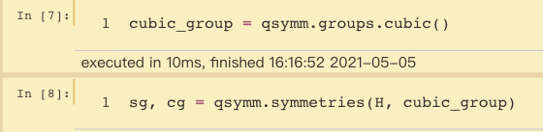
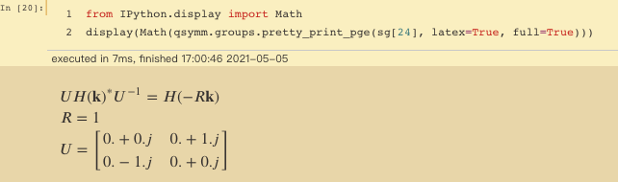
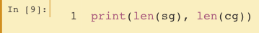
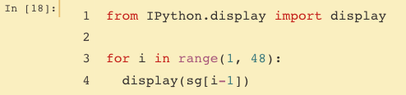
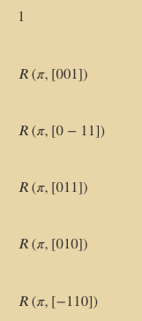
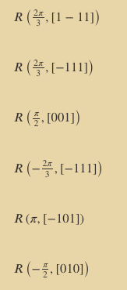
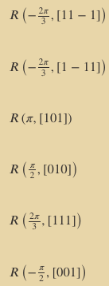
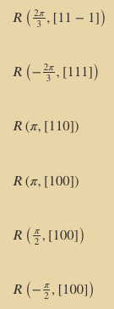

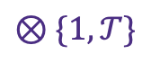
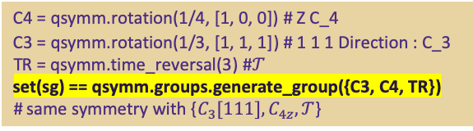
Find Symmetry a simple example: 3D rashba
start from the cubic group as the set of candidates for point group symmetries:
We can also get a more detailed representation of these group elements:
we can use symmetries to find point group symmetries,
discrete onsite symmetries, and continuous symmetries:
$$𝒯$$
we have 48 symmetries, but no continuous symmetries:
All the symmetry we find
We can check that this is the same as the full cubic group without inversion, plus time-reversal
C4 = qsymm.rotation(1/4, [1, 0, 0]) # Z C_4
C3 = qsymm.rotation(1/3, [1, 1, 1]) # 1 1 1 Direction : C_3
TR = qsymm.time_reversal(3) #$𝒯$
set(sg) == qsymm.groups.generate_group({C3, C4, TR})
# same symmetry with {$C_{3}[111], C_{4z},𝒯$}
$$⊗\{1,𝒯\}$$

Slide 5
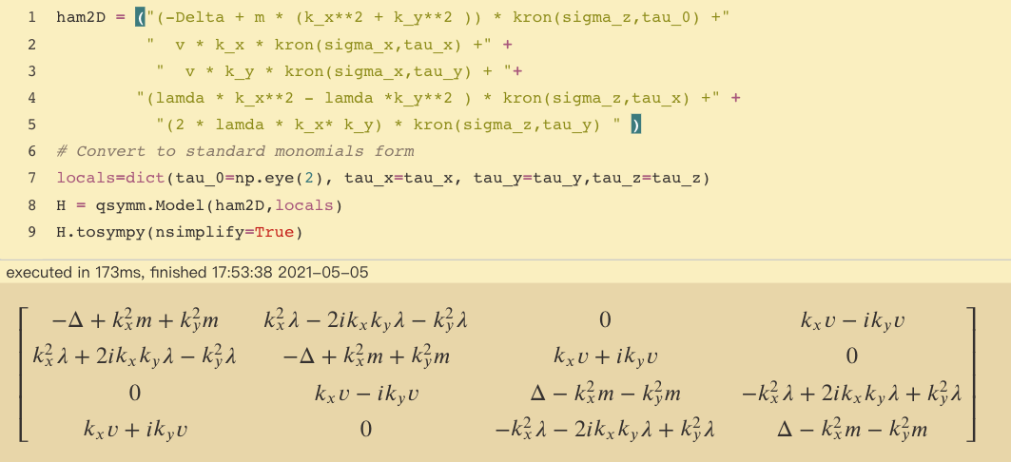
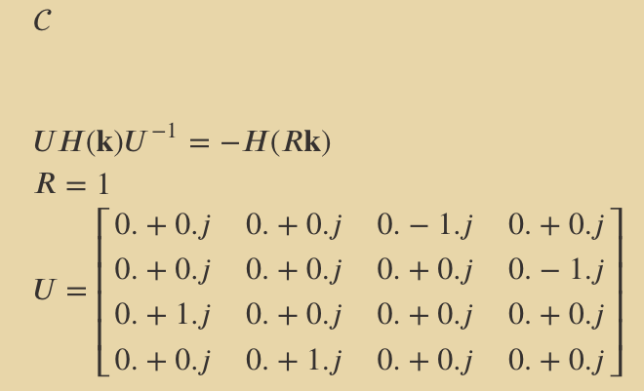
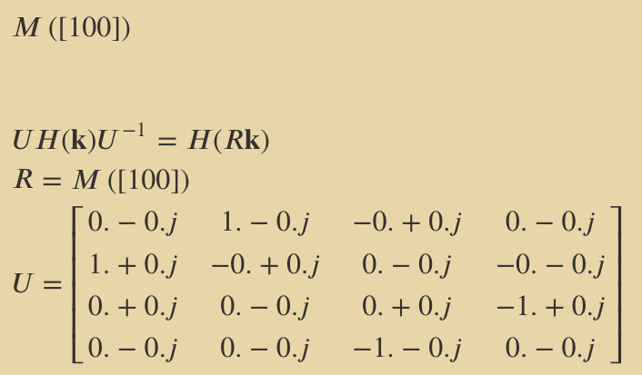
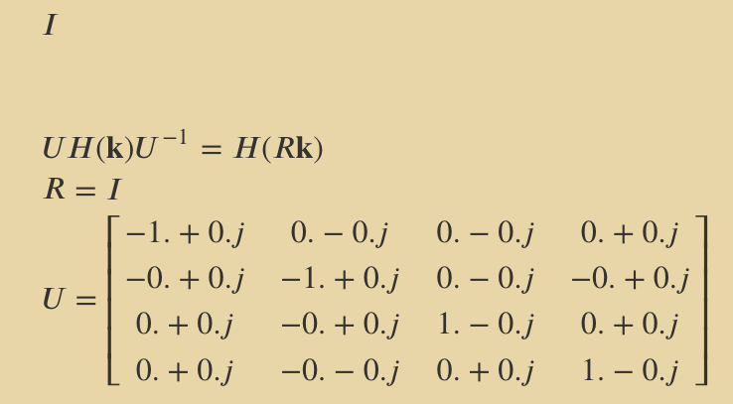
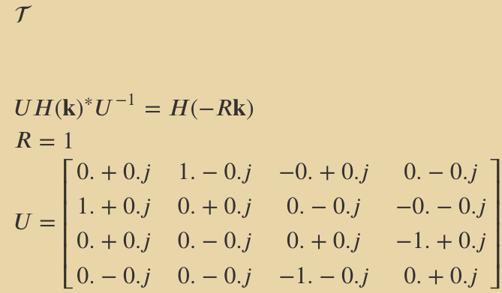
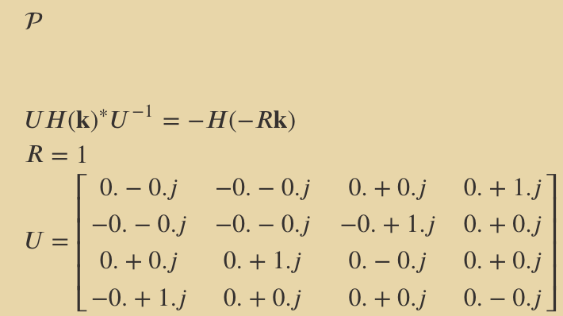

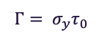
Find Symmetry a practical example:
$$\begin{aligned}ℋ_{2D}=&\left(−Δ+mk_{x}^{2}+mk_{y}^{2}\right)σ_{z}τ_{0}+vk_{x}σ_{x}τ_{x}+vk_{y}σ_{x}τ_{y} \\ &+λ\left(k_{x}^{2}−k_{y}^{2}\right)σ_{z}τ_{x}+2λk_{x}k_{y}σ_{z}τ_{y}\end{aligned}$$
SOTI
$$Γ= σ_{y}τ_{0}$$
Find Chiral Symmetry
Find Mx Symmetry
same as Pro.Zhao
Find Inversion Symmetry
Find Time-reversal Symmetry
minus sign
minus sign
hexagonal_group = qsymm.groups.hexagonal(dim=3)
sg, cg = qsymm.symmetries(H,hexagonal_group)
we find 32 operations
Naturally, Particle-hole symmetry
Has not found C3z
Wrong set of initial U matrix

Slide 6
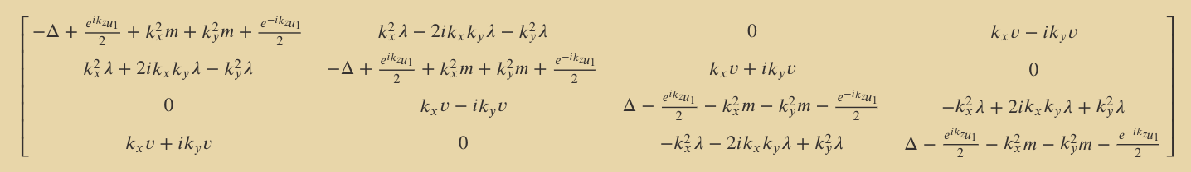
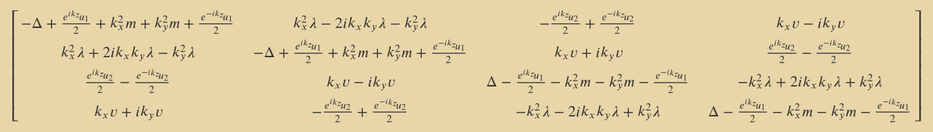
Find Symmetry a practical example:
$$ℋ=ℋ_{2D}−u_{1}\cos\left(k_{z}d\right)σ_{z}τ_{0}−u_{2}\sin\left(k_{z}d\right)σ_{y}τ_{z}$$
HODSM
HONLSM
The HODSM kp
same symmetry with the H_2D
The HONLSM kp
lost Chiral and Particle-hole symmetry

Slide 7
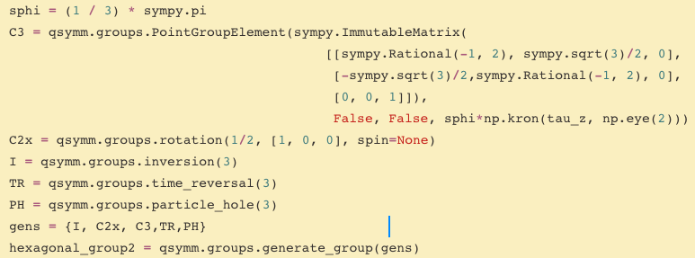
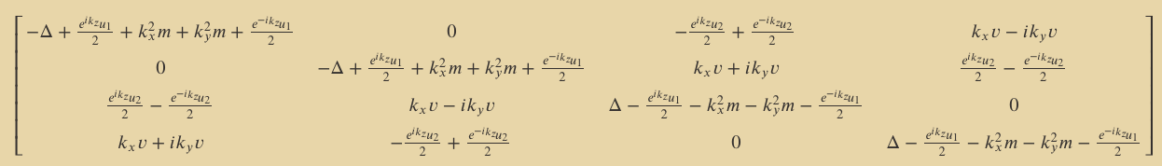
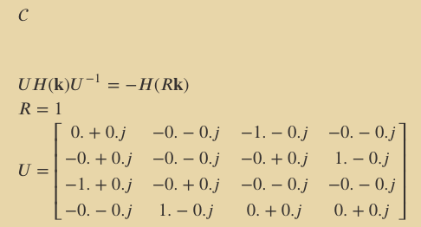
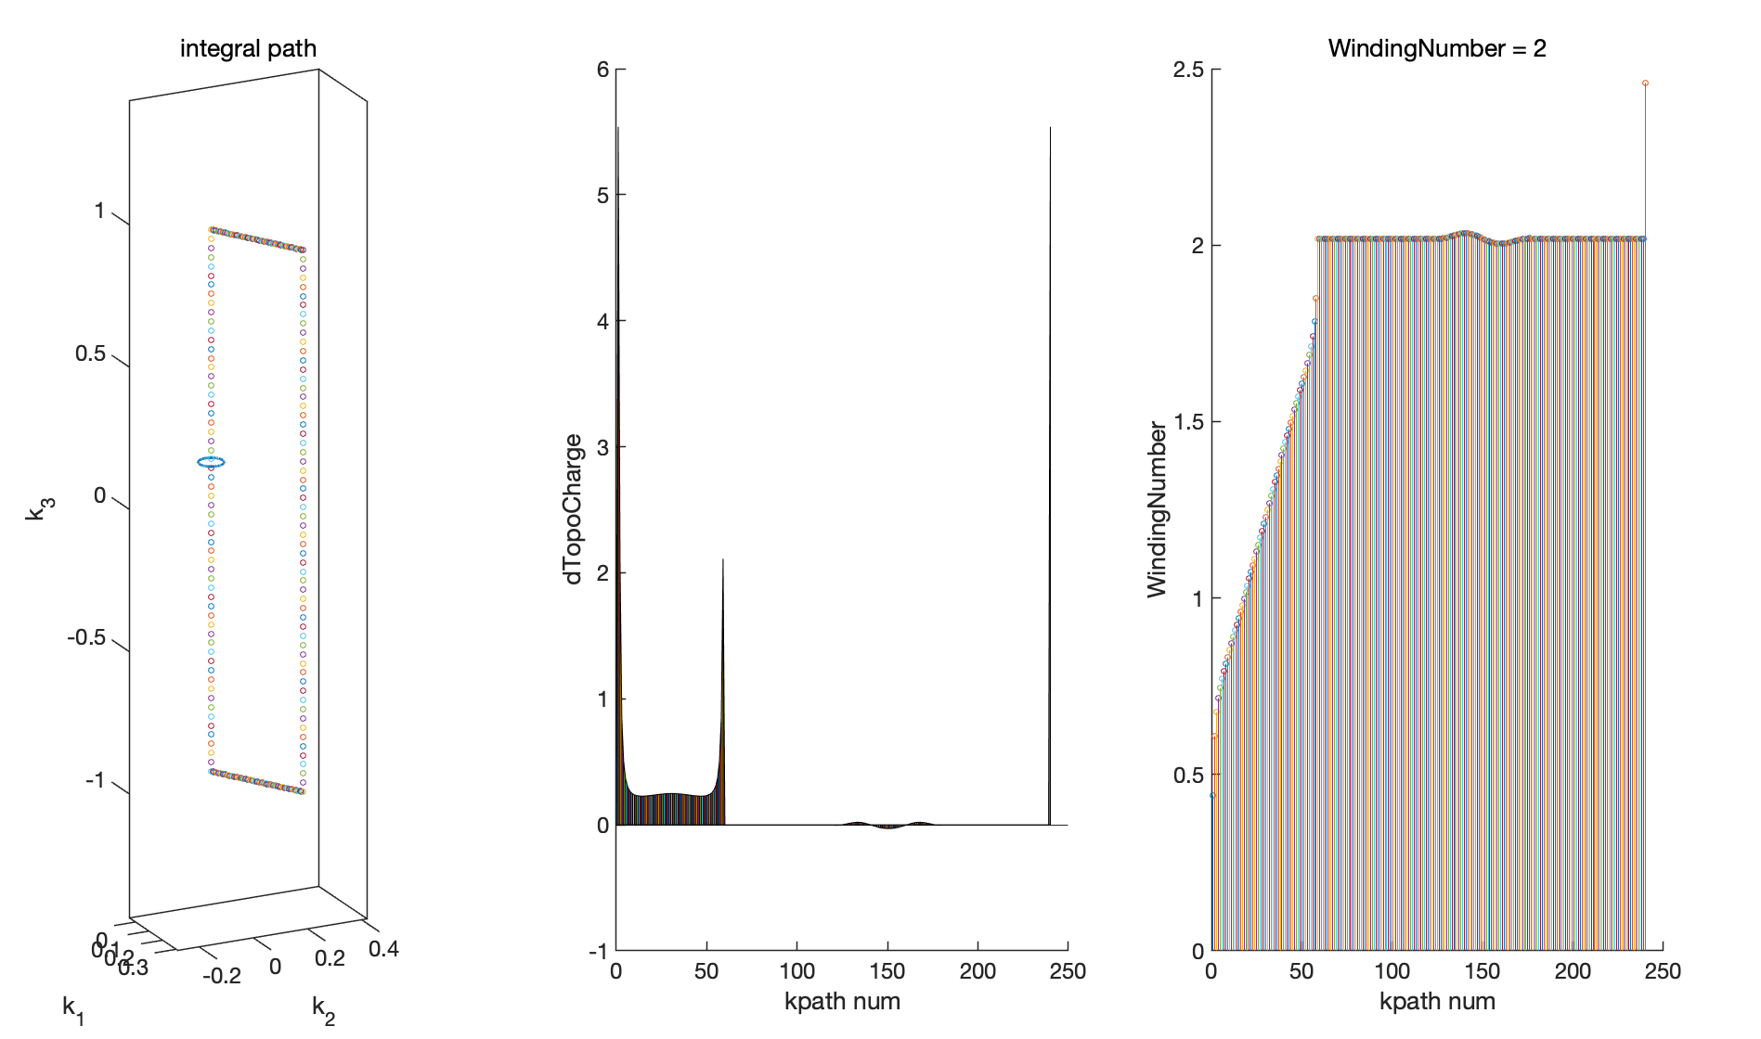
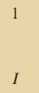
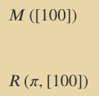
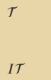
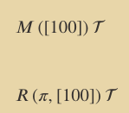
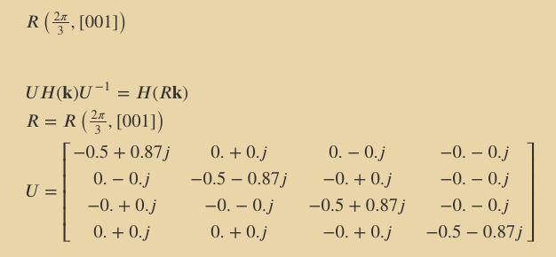

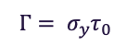
Find Symmetry an advance example:
$$\begin{aligned}ℋ_{2D}=&\left(−Δ+mk_{x}^{2}+mk_{y}^{2}\right)σ_{z}τ_{0}+vk_{x}σ_{x}τ_{x}+vk_{y}σ_{x}τ_{y} \\ &+λ\left(k_{x}^{2}−k_{y}^{2}\right)σ_{z}τ_{x}+2λk_{x}k_{y}σ_{z}τ_{y}\end{aligned}$$
SOTI
$$ℋ=ℋ_{2D}−u_{1}\cos\left(k_{z}d\right)σ_{z}τ_{0}−u_{2}\sin\left(k_{z}d\right)σ_{y}τ_{z}$$
HODSM
HONLSM
$$Γ= σ_{y}τ_{0}$$
Generate the group elements by ourselves
If we ignore SOTI term,
we have C3z symmetry and an emergent Chiral symmetry
use this
Gamma Operator
We found this kp model has no C3z symmetry as well
only
T P C2x(Mx)

Slide 8
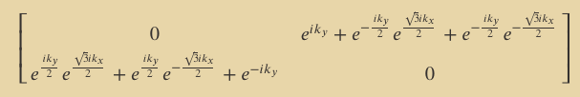
Gen symmetry TB model a simple example: Graphene
Define symmetry Group: time-reversal symmetry, sublattice (or chiral) symmetry, and threefold rotation symmetry
Change it into HR
Define orbital: A B 2 orbs;
‘A’,’B’, 等价于 1,2 斜对角的hopping
[0,1] 方向 等价于 vector
Gen TB model

Slide 9
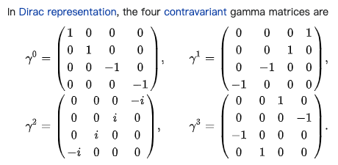
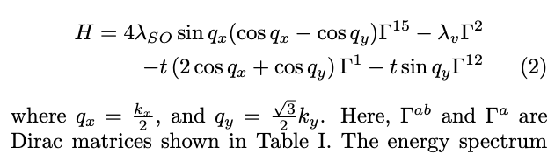
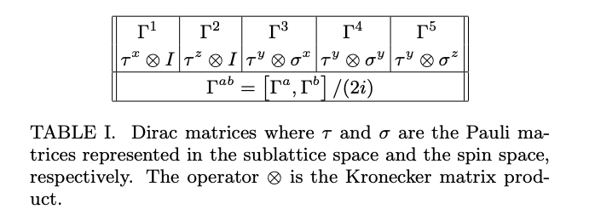
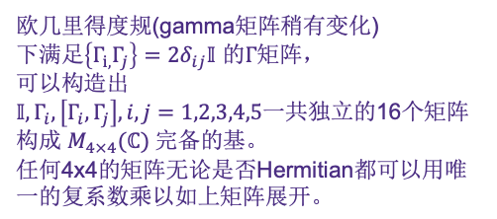
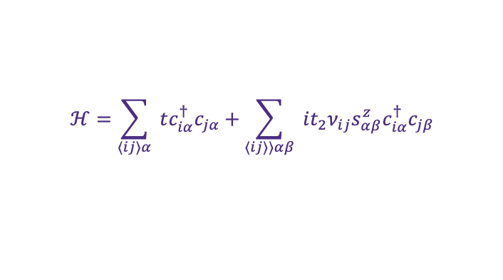
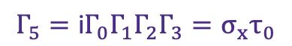
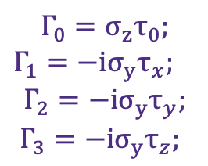
Generate symmetry TB model an advanced example: find symmetry of Kane-Mele
$$ℋ=\sum_{⟨ij⟩α}{ }tc_{iα}^{†}c_{jα}+\sum_{⟨ij⟩⟩αβ}{ }it_{2}ν_{ij}s_{αβ}^{z}c_{iα}^{†}c_{jβ}$$
Five Dirac Matrix
sympy use this notation
$$Γ_{0}=σ_{z}τ_{0};$$
$Γ_{1}={−iσ}_{y}τ_{x};$
$$Γ_{2}={−iσ}_{y}τ_{y};$$
$Γ_{3}={−iσ}_{y}τ_{z};$
https://arxiv.org/pdf/1408.4507.pdf
$$Γ_{5}=\text{i}Γ_{0}Γ_{1}Γ_{2}Γ_{3}=σ_{x}τ_{0}$$
欧几里得度规(gamma矩阵稍有变化)
下满足$\left\{Γ_{i,}Γ_{j}\right\}=2δ_{ij}𝕀$ 的$Γ$矩阵，
可以构造出
$𝕀,Γ_{i},\left[Γ_{i},Γ_{j}\right],i,j=1,2,3,4,5$一共独立的16个矩阵
构成 $M_{4×4}(ℂ)$ 完备的基。
任何4x4的矩阵无论是否Hermitian都可以用唯一的复系数乘以如上矩阵展开。
Notes:
其优越性在于，如果我们记除去单位矩阵的这15个矩阵为, 那么有$\left\{Γ_{i,}Γ_{j}\right\}=2δ_{ij}𝕀$ ,从而哈密顿本征值可以一眼看出。

Slide 10
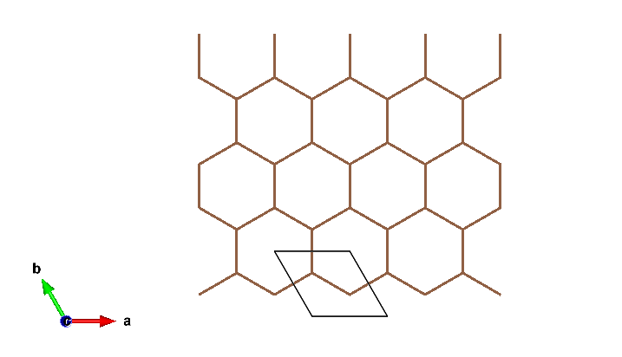
…
Harper equation
j=…
j=3
j=2
…
…
j=1

Slide 11
Generate symmetry TB model an advanced example: find symmetry of Kane-Mele
$$ℋ=t\left(\left(−2cos\left(\frac{k_{x}}{2}\right)−cos\left(\frac{\sqrt{3}k_{y}}{2}\right)\right)σ_{x}s_{0}−sin⁡(\frac{k_{x}}{2})σ_{y}s_{0}\right)+{4λ}_{so}sin\left(\frac{k_{x}}{2}\right)(cos\left(\frac{k_{x}}{2}\right)−cos\left(\frac{\sqrt{3}k_{y}}{2}\right)) σ_{z}s_{z}$$
Notes:
其优越性在于，如果我们记除去单位矩阵的这15个矩阵为, 那么有$\left\{Γ_{i,}Γ_{j}\right\}=2δ_{ij}𝕀$ ,从而哈密顿本征值可以一眼看出。

Slide 12
Generate symmetry TB model an advanced example: Kane-Mele
Define symmetry Group: time-reversal symmetry, sublattice (or chiral) symmetry, and threefold rotation symmetry
Change it into HR
Define orbital: A B 2 orbs;
‘A’,’B’, 等价于 1,2 斜对角的hopping
[0,1] 方向 等价于 vector
Gen TB model

Slide 13
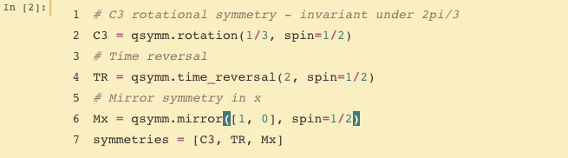






Gen kp example: Bi2Te3
the surface Hamiltonian
$$H(\vec{k})=E_{0}(k)+v_{k}\left(k_{x}σ_{y}−k_{y}σ_{x}\right)+\frac{λ}{2}\left(k_{+}^{3}+k_{−}^{3}\right)σ_{z}$$
where $E_{0}(k)=k^{2}/\left(2m^{∗}\right)$ generates particle-hole asymmetry
the Dirac velocity $v_{k}=v(1+αk^{2})$contains a second-order correction.
as same as
$$E_{±}(\vec{k})=E_{0}(k)±\sqrt{\left.v_{k}^{2}k^{2}+λ^{2}k^{6}\cos^{2}{(}3θ\right)}$$
C3 Mx Tr
the cubic term explain the snowflake fermi surface
observed in experiment

Slide 14






Gen kp example: BHZ
Consider $C_{4z},M_{y}, 𝓟 and 𝓣at Γ point$
$$\left(\begin{matrix}\left.M(k\right) & Ak_{+} & 0 & 0 \\ Ak_{−} & \left.−M(k\right) & 0 & 0 \\ 0 & 0 & \left.M(k\right) & −Ak_{−} \\ 0 & 0 & −Ak_{+} & \left.−M(k\right)\end{matrix}\right)$$
Science, 314, 1757 (2006).
P, T C4z
Consider $C_{4z},M_{x}, 𝓟 and 𝓣at Γ point$
$$\left(\begin{matrix}\left.M(k\right) & iAk_{+} & 0 & 0 \\ −iAk_{−} & \left.−M(k\right) & 0 & 0 \\ 0 & 0 & \left.M(k\right) & iAk_{−} \\ 0 & 0 & −iAk_{+} & \left.−M(k\right)\end{matrix}\right)$$
notice the sign before the theta is opposite from our common using
def inversion(realspace_dim, U=None)
def rotation(angle, axis=None, inversion=False, U=None, spin=None):
def mirror(axis, U=None, spin=None):
def particle_hole(realspace_dim, U=None):
def chiral(realspace_dim, U=None):
def time_reversal(realspace_dim, U=None, spin=None):

Slide 15




Gen kp example: 3DTI
Nature Physics 5, 438–442 (2009)
P, T C3z

Slide 16





Gen kp example: SnTe
仅仅分析kp 只要说的很详细
也可以PRL
EuAgAs family !
10.1103/PhysRevLett.122.186801(2019)
breaks C3 symmetry
additional term
P, T C3z
$$\begin{aligned}H_{1}(k)=&δν\left(k_{1}s_{2}+k_{2}s_{1}\right)σ_{x}+λ_{1}k_{1}s_{3}σ_{x}+λ_{2}k_{2}σ_{y} \\ &+λ_{3}k_{3}s_{1}σ_{x}+δf\left(k_{1}^{2}−k_{2}^{2}\right)σ_{z}+gk_{2}k_{3}σ_{z}\end{aligned}$$
learning kp analysis
recommend this ！（thumb）

Slide 17
Gen kp Continues group , for further exploration
we can still adapt this function

Slide 18
HINT
Copy and extract the essence of the Qsymm group class and kp gen/sym find class
double check the kp in EuIn2As2 with all kp gen tools
use kp2TB to explain the Topological transition by symmetry-broken from mag
figure out the notion of C3 symmetry in TB and kp
try to code the symTB in matlab with the help of European Bro.

